Slide 1
Nervous system
Dr.Deepa.G.S
Associate Professor
SKHMC

Slide 2
Neuron-Nerve cell
Structural and functional unit of nervous system
Has axon and dendrites
No centrosome
Nerve cell is present in the grey matter, dendrites and axon are present in the white matter
5µm to 120 µm
Human nervous system has 10¹² neurons

Slide 3
Neuron-Structure
http://droualb.faculty.mjc.edu/Course%20Materials/Elementary%20Anatomy%20and%20Physiology%2050/Lecture%20outlines/nervous_system.htm

Slide 4
Nerve cell body-Structure
Nissl granules
Basophilic granules composed of thin parallely arranged membrane bound cavities which is covered by RNA with proteins
Neurofibrillae
These are fine threads 6-10 nm in diameter and varies in length

Slide 5
Dendrites
5-7 procesees extending out the cell body and arborize after leaving the cell
Receptive process of neuron
Contains Nissl granules, mitochondria and neurofibrillae

Slide 6
Axon
Arise from thickened area of cell body-Axon hillock in which there is no nissl granules
Single and conducts away from the cell body
Axoplasm- Cytoplasmic fluid in the center of axon
Axolemma-Cell membrane
Length-few microns -90cms

Slide 7
Myelin sheath
Protein-Lipid complex made up of many layers
of unit membrane which envelopes the axon
except at its endings and at periodic
constrictions about 1 mm apart called nodes
of Ranvier
Functions
Faster conduction-Saltatory conduction
Insulating capacity-confines impulses to individual fibers

Slide 8
Myelinogenesis
Peripheral nervous system – Schwann cells of neurilemma
Starts at 4th month of Intra uterine life
Completed in 2nd year of life
Central Nervous system-Oligodendroglia

Slide 10
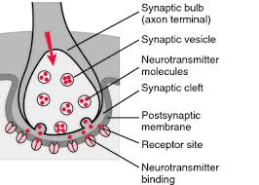
Neuron-Synaptic knobs
Axon divides into terminal branches each ends in a number of synaptic Knobs
Contains granules or vesicles in which synaptic transmitter is stored
https://medical-dictionary.thefreedictionary.com/synapse

Slide 11
https://www.sciencefacts.net/parts-of-a-neuron.html

Slide 12
https://www.shutterstock.com/image-vector/anatomy-nerve-97755608

Slide 13
Neurons-Classification
Classification
Based on number of poles
Based on function
Based on length of axon

Slide 14
Neurons-Classification based on number of poles

Slide 15
Neurons-Classification
Based on function
Motor
Sensory
Based on Length
Golgi Type I
Golgi Type II

Slide 16
Neurons-Classification based on functions
https://www.tutor2u.net/psychology/reference/biopsychology-sensory-relay-and-motor-neurons

Slide 17
https://www.quora.com/Do-motor-neurons-have-the-same-structure-as-sensory-neurons

Slide 18
Neurons-Classification based on length
https://www.jaypeedigital.com/eReader/chapter/9789350909409/ch1

Slide 19
Nerve fibers-Classification
Based on myelination
Myelinated
Non-myelinated
Based on distribution
Somatic
Visceral or Autonomic

Slide 20
Nerve fibers-Classification
Based on function
Sensory
Motor
Based on Neurotransmitters
Adrenergic
Cholinergic
Based on Origin
Cranial
Spinal

Slide 21
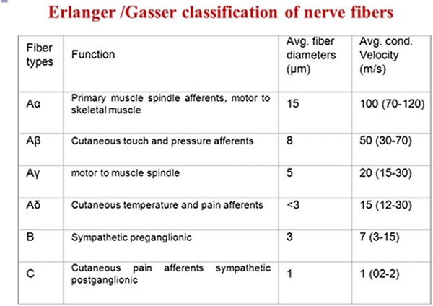
Nerve fibers-Classification
Based on diameter and conduction of impulse

Slide 22
Properties of nerve fibers
Excitability – respond to external or internal stimulus
Two type of Response based on strength of stimulus
1.Threshold stimulus- Action potential
2.Subminimal stimulus-electronic potential

Slide 23
Action potential in nerve fiber
https://commons.wikimedia.org/wiki/File:1222_Action_Potential_Labels.jpg

Slide 24
Properties of Nerve fiber-Conductivity
Conductivity – ability to transmit the impulse
Myelinated nerve fibers-Saltatory conduction
Entry of ions takes place only in nodes of Ranvier, so the action potential jumps from one node to another
50 times faster than through non-myelinated nerve fiber

Slide 25
http://www.as.wvu.edu/~rbrundage/chapter4b/sld021.htm

Slide 26
Properties of Nerve fiber-Conductivity
https://www.britannica.com/science/saltatory-conduction

Slide 27
Properties of Nerve fiber-Refractory period
Refractory period
The period where nerve does not give respond to
a second stimulus
Absolute Refractory Period-Nerve does not show any respond at all whatever may be the strength of stimulus
Relative refractory Period -Nerve fiber shows response when the strength of stimulus is incraesed

Slide 28
Properties of Nerve fiber-Adaptation
Adaptation
When stimulating a nerve fiber continuously the excitability is greater in the beginning and the response decrease slowly and finally the nerve does not shows the response
Cause
Continuous depolarization inactivates sodium pump and increases potassium ions

Slide 29
Properties of Nerve fiber- Summation
Summation
When two or more subliminal stimuli are
applied within short interval of time the
response is produced
Infatigability
All or None law
When a nerve is stimulated it gives maximum
response or does not give response at all

Slide 30
Reference:
Text book of Medical Physiology:Geetha N 2nd edition
Essentials of medical Physilology:K.sembulinhgam Prema sembulingam,Eigth edition
Text book of Physiology:Prof.A.K.Jain,Fourth edition

Slide 31
Thank You

